Slide 1
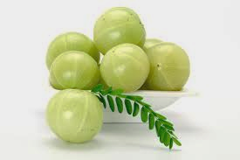
ANN, CNN, RNN
Instructors: Vaidehi Iyer/Konstantin Borozdin
Course Offered by:
AMLA
Advanced Machine Learning Applications

Slide 2
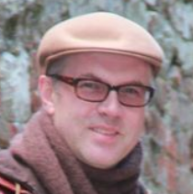
About Instructors
Vaidehi Iyer is a data scientist and quality assurance manager with over 20 years of experience in the corporate world. During her career she consistently and efficiently applied her knowledge of statistics and applied mathematics (she has Master of Science degrees in both these fields) to product quality improvement, while also focusing on product development process
Konstantin Borozdin devoted 25 years to scientific research spanning from space science and astrophysics to experimental particle physics, cosmological simulations and advanced imaging applications. Starting his career at Moscow Space Research Institute of Russian Academy of Sciences, he then spent 15 years at Los Alamos National Laboratory of US Department of Energy. His research has
efficiency. She is a Six Sigma Black Belt and certified ISO instructor. She is passionate about technology and has a wealth of experience in applying cutting-edge innovations in performance and capacity analysis, root cause analysis of product non-compliances, predictive analytics and machine learning to real-world problems. Sharing her knowledge and educating is her another passion. She had experienced teaching and instructing at different levels, from running a home school for underprivileged children in India to providing training to employees. She is currently coaching math olympiad teams at elementary and middle schools. She is a Co-Founder of AMLA Corporation focused on advanced machine learning applications and providing educational and early-career employment opportunities. Besides English, Vaidehi is speaking her native Gujarati, as well as Hindi language.
been focused on scientific data analysis, with increasing emphasis on machine learning methods. With M.Sc. degree in experimental nuclear physics and Ph.D. in physics and mathematics, he is an author of more than 100 research articles and holds several US and international patents. In last several years he has been focusing on real-world application of his research as a Vice-President for Analytics of a high-tech start up company Decision Sciences with headquarters at Poway, CA. Throughout his career he has been mentoring students and graduate students, and leading diverse research teams. He is an excellent communicator, with extensive experience of involvement in international collaborations and language proficiency in English and Russian.
‹#›

Slide 3
Neural Network
Supervised | Artificial Neural Network | Regression & Classification
 | Convolutional Neural Network | Computer Vision
 | Recurrent Neural Network | Time Series Analysis
UnSupervised | Self-Organizing Maps | Feature detection
 | Deep Boltzmann Machines | Recommendation Systems
 | Auto Encoders | Recommendation Systems

Slide 4
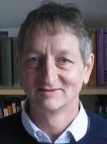
Geoffrey Hinton
Godfather of ANN & Deep Learning
Spent 4 decades in developing deep learning based on understanding how the brain works
Pioneering Brain Team Toronto at Google & University of Toronto

Slide 5
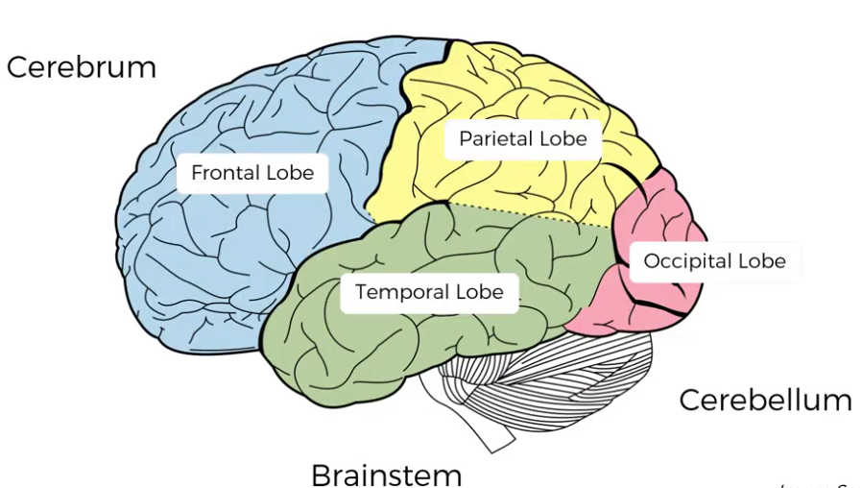
Neural Network - Human Brain

Slide 6
Artificial Neural Networks

Slide 7
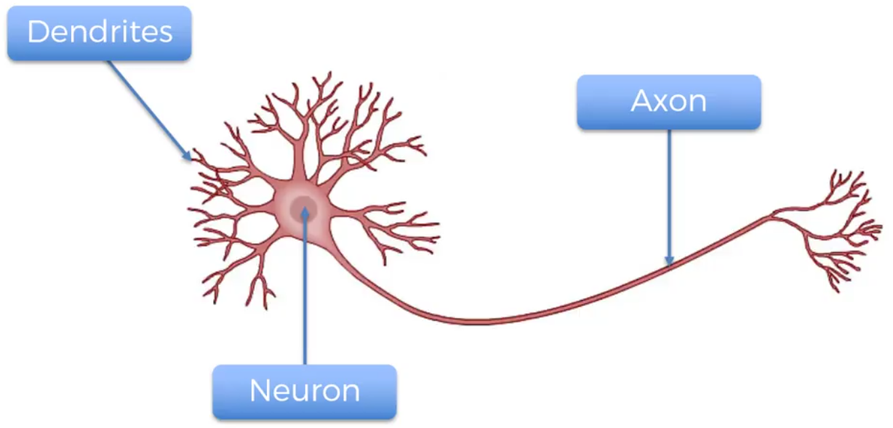
The Neuron

Slide 8
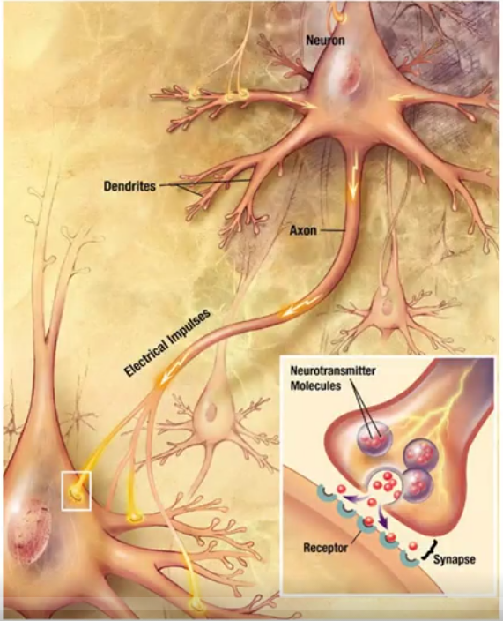
The Neuron

Slide 9
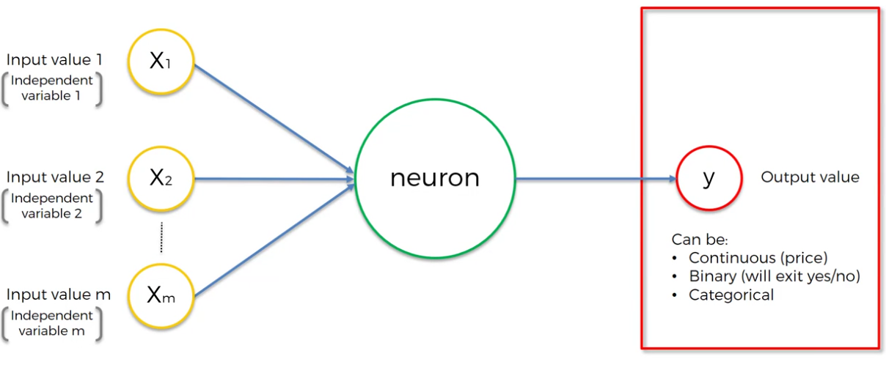
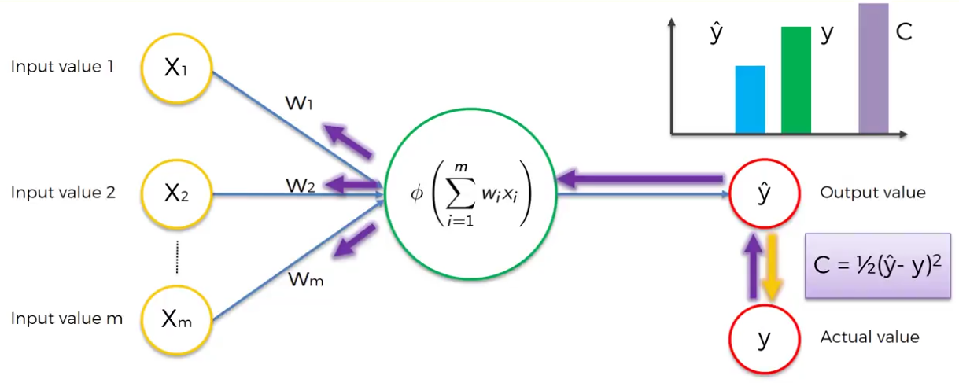
Artificial Neural Network

Slide 10
Convolutional Neural Networks

Slide 11
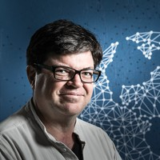
Yann Lecun
Godfather of CNN
Student of Geoffrey Hinton
Director of AI research at Facebook & Founding Director of Center for Data Science at NYU

Slide 12
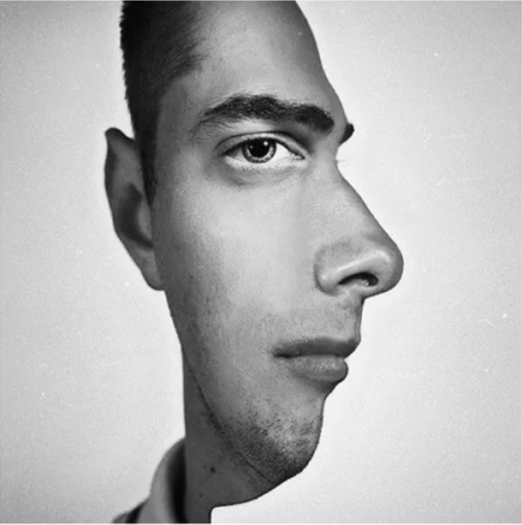
What is CNN?
What do you see?
Do you see a person looking at you?
OR
A person looking to the right?

Slide 13
Application of CNN
CNN is useful in image related tasks for image classification, image semantic segmentation, object detection in the image, etc.
CNN
Output Label
Input Image

Slide 14
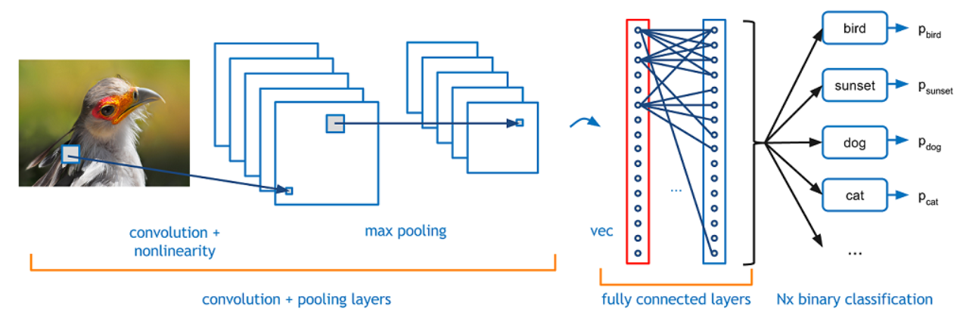
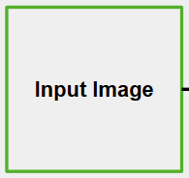
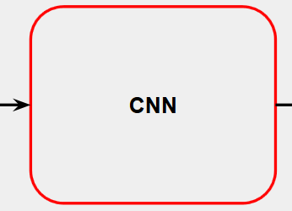
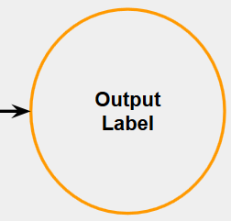
CNN Overview
https://adeshpande3.github.io/adeshpande3.github.io/A-Beginner%27s-Guide-To-Understanding-Convolutional-Neural-Networks/

Slide 15

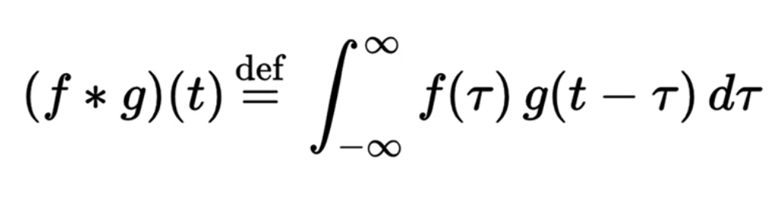
Convolution Function
Convolution is an integration of two functions. It shows how one function modifies another.

Slide 16
CNN Steps
Input Image
Feature Detector
Feature Mapping
Max Pooling
Flattening
Full Connection

Slide 17
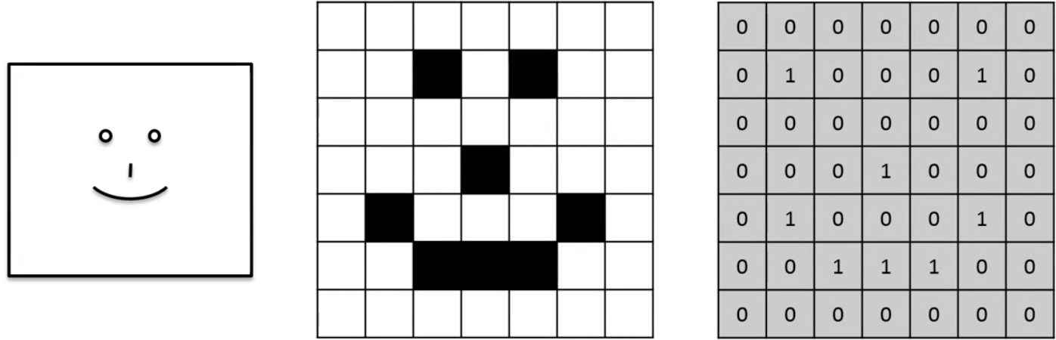
Smiley Face in Numbers

Slide 18
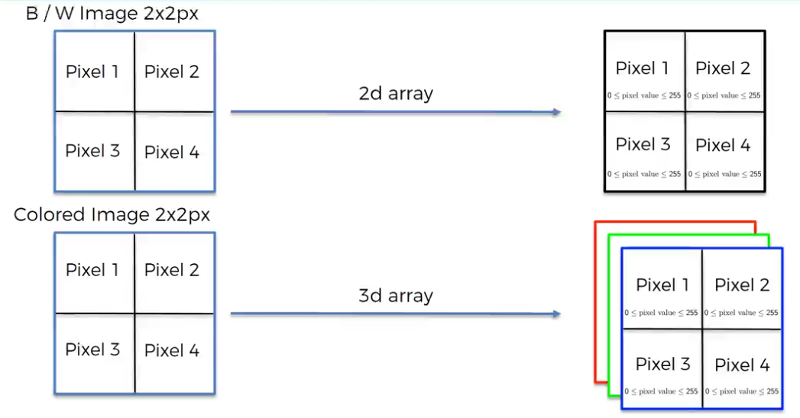
Color Image is Just 3 Greyscale Images

Slide 19
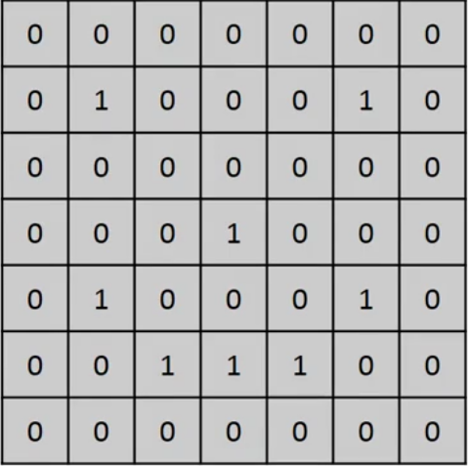
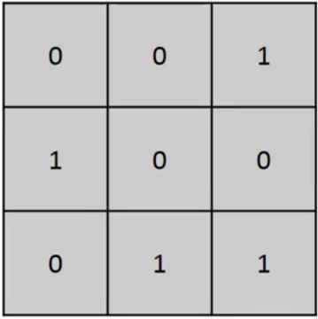
Input Image Feature Detector

Slide 20
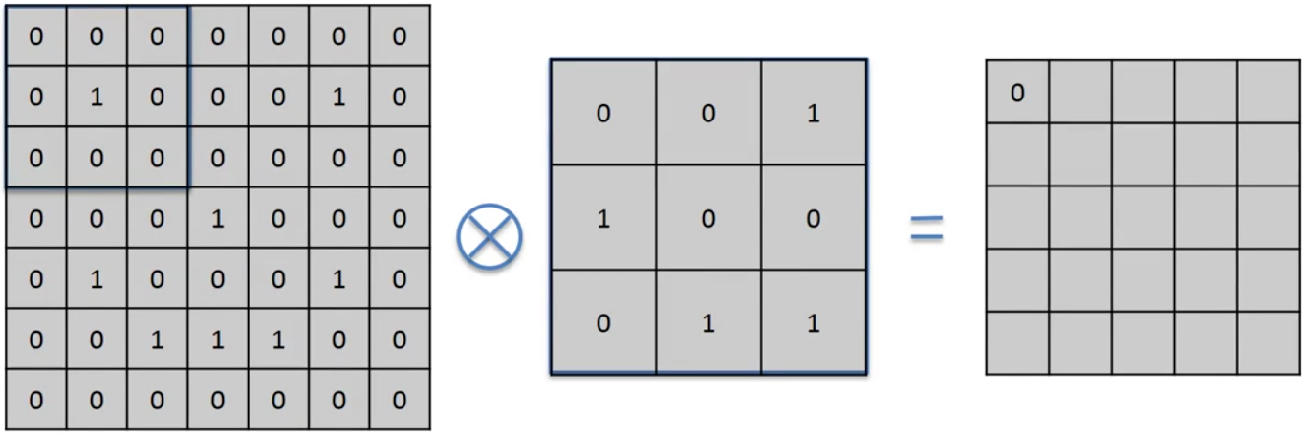
Convolution

Slide 21
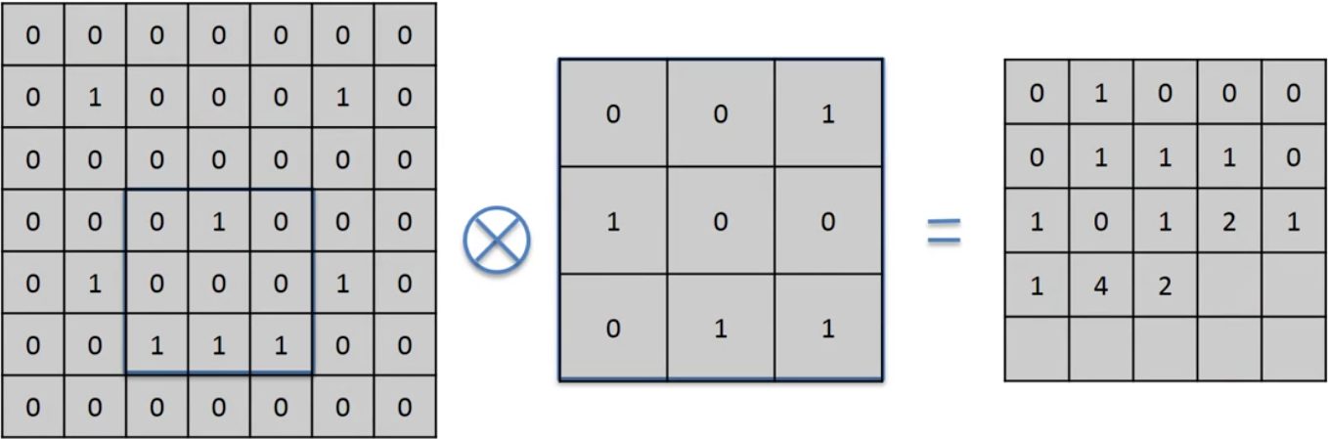
Convolution

Slide 22
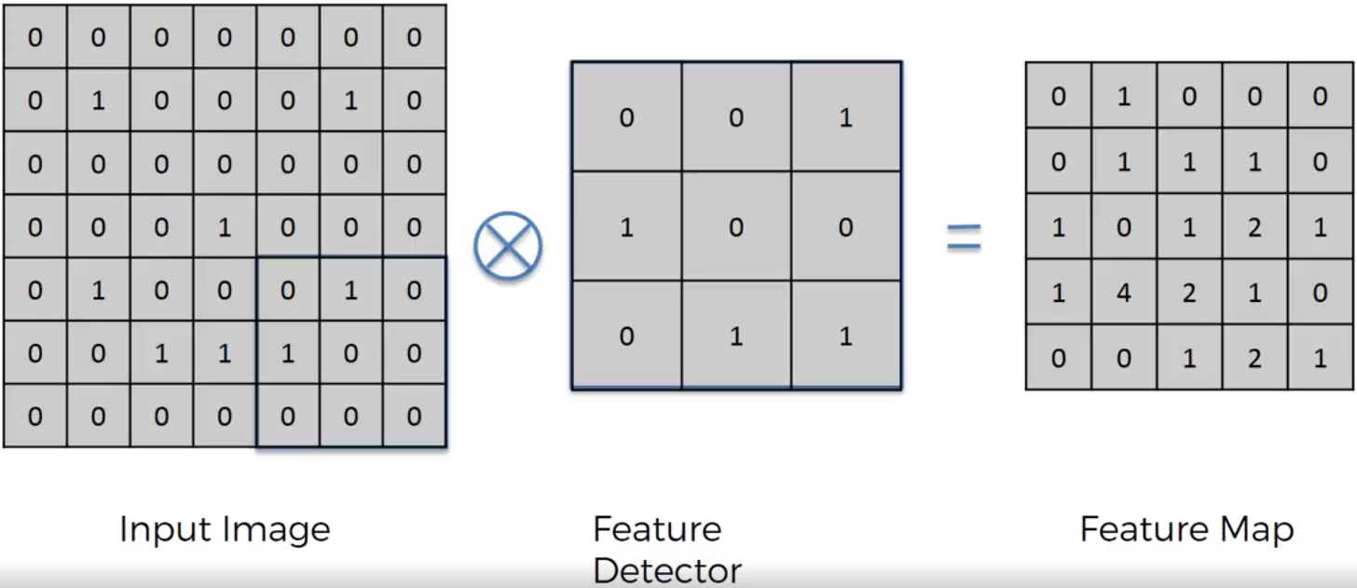
Convolution

Slide 23
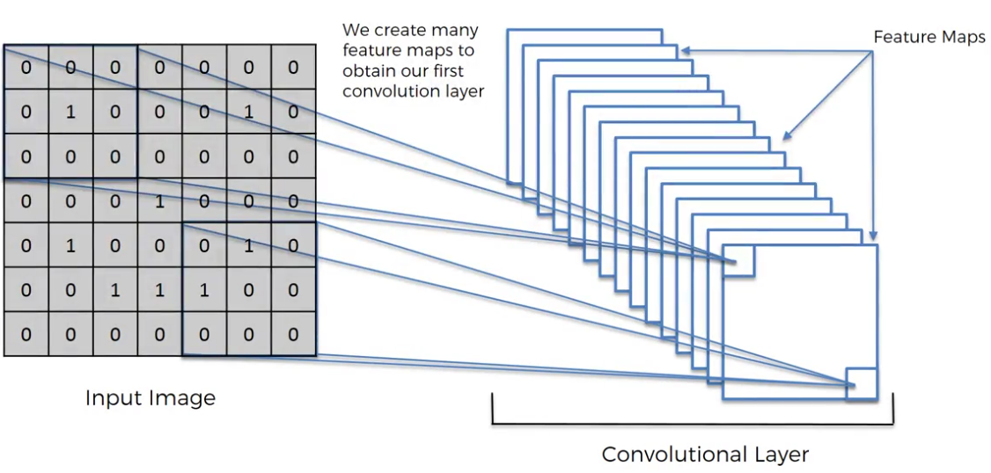
Convolutional Layer

Slide 24
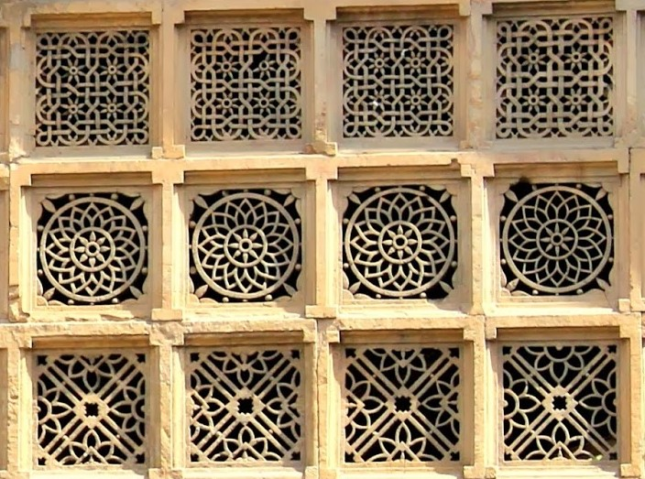
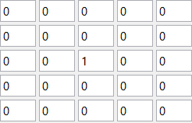
Original Image

Slide 25
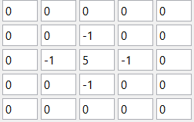
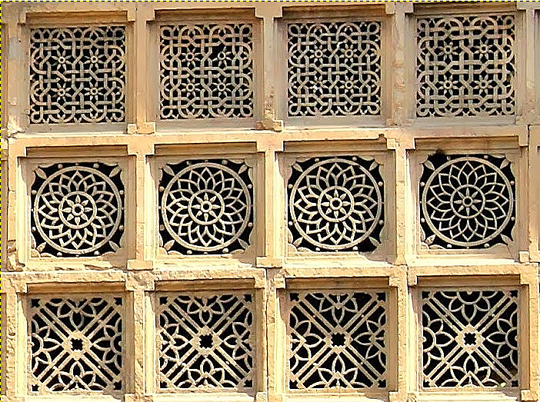
Original Vs Sharpen

Slide 26
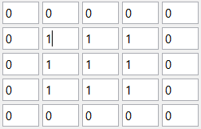
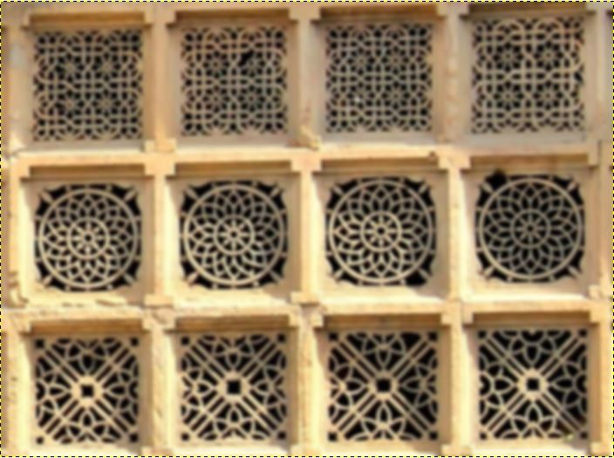
Original Vs Blur

Slide 27
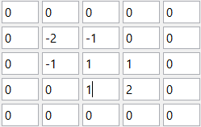
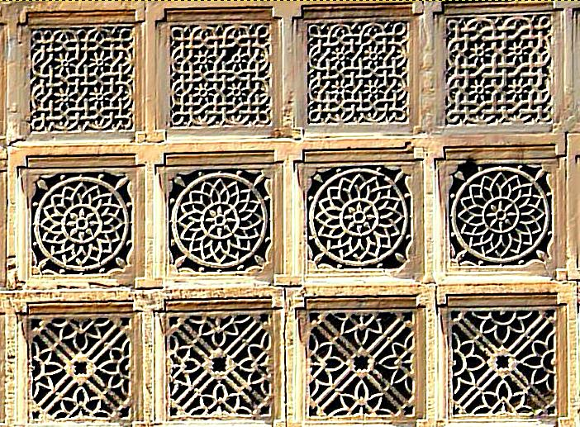
Original Vs Emboss

Slide 28
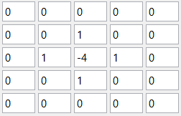
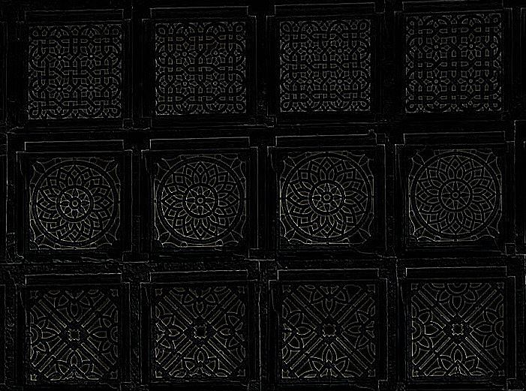
Original Vs Edge Detect

Slide 29
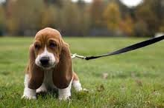
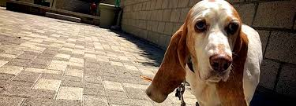
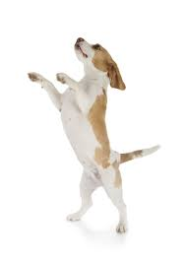
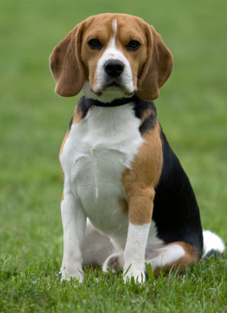
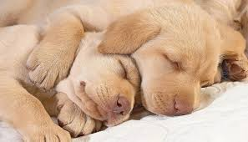
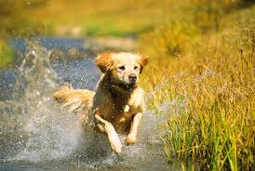
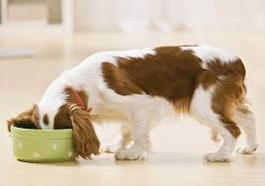
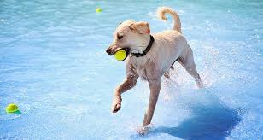
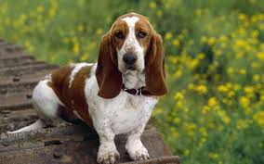
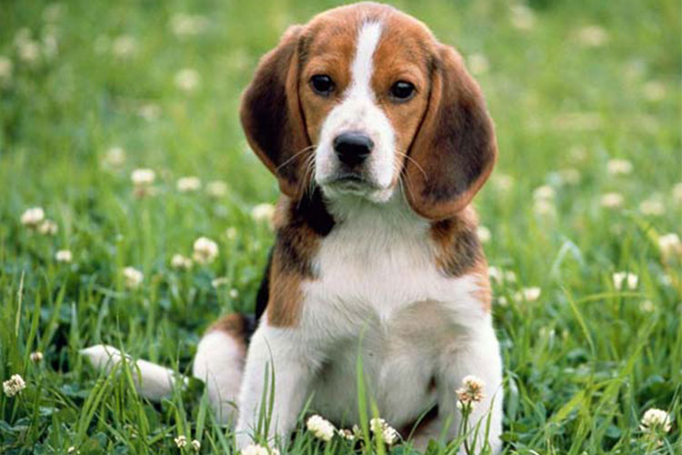
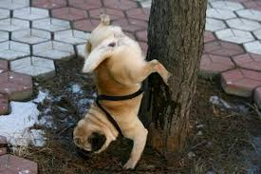
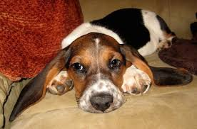

Slide 30
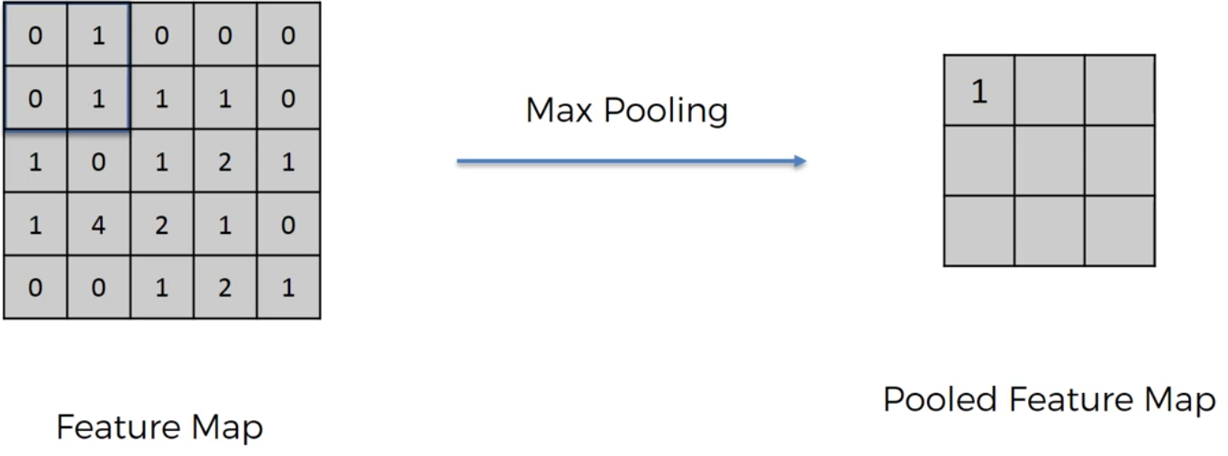
Max Pooling

Slide 31
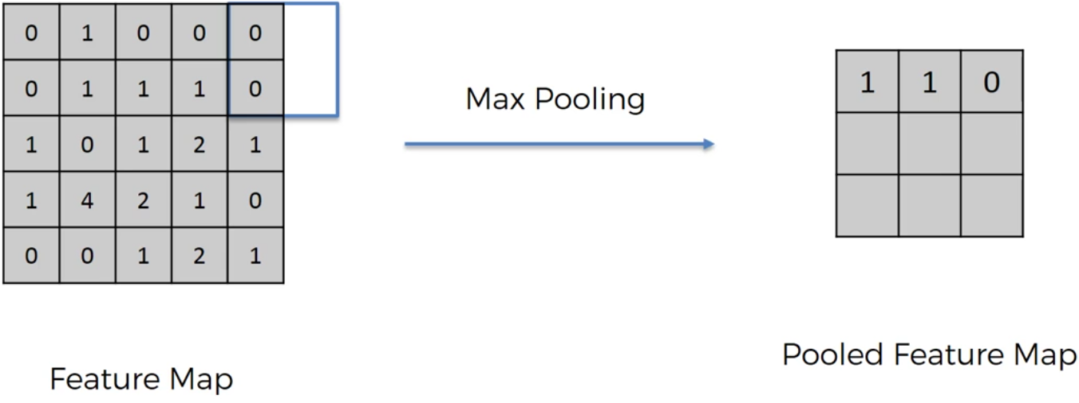
Max Pooling

Slide 32
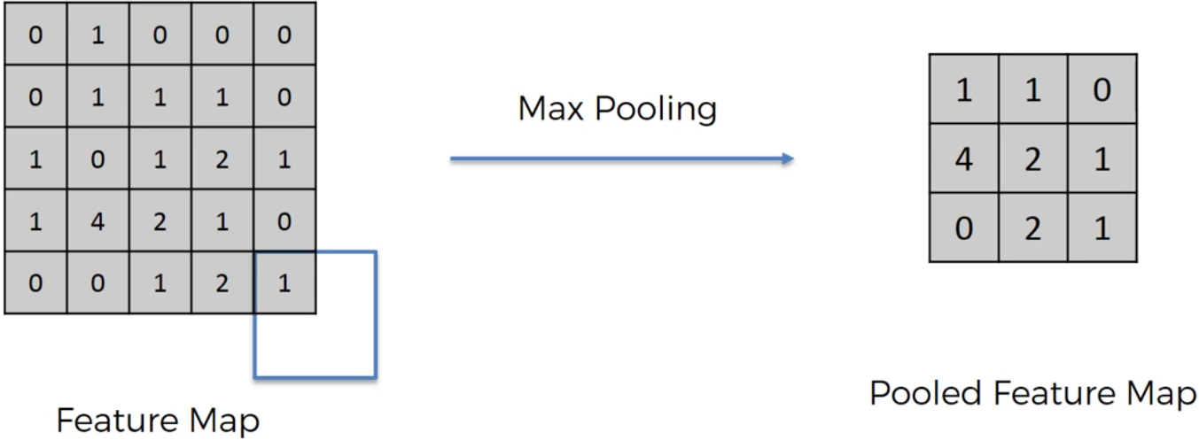
Max Pooling

Slide 33
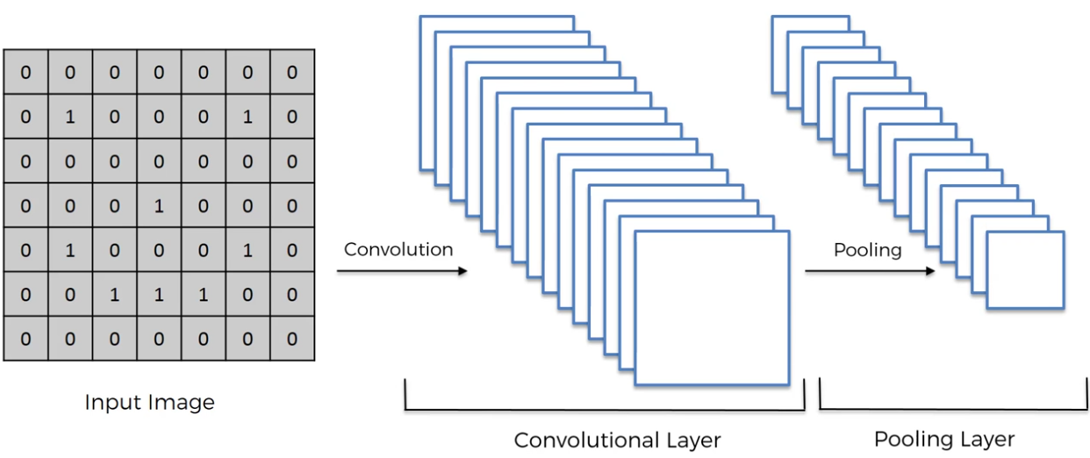

Slide 34
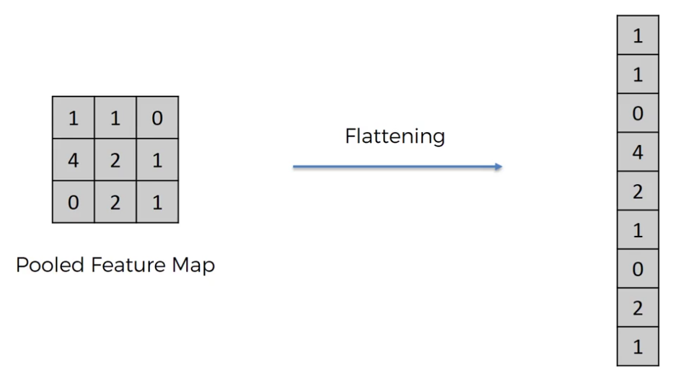
Flattening

Slide 35


Slide 36

Full Connection

Slide 37


Slide 38
Recurrent Neural Networks

Slide 39



Idea behind Recurrent Neural Nets
Vanilla Neural Net
Recurrent Neural Net
2 x 2 = 4
E = mc²
Cat
I am not cooking tonight because my husband forgot to buy milk yesterday
https://medium.com/@ageitgey/machine-learning-is-fun-part-5-language-translation-with-deep-learning-and-the-magic-of-sequences-2ace0acca0aa

Slide 40



Example of Recurrent Algorithm
Fibonacci was probably the greatest genius of number theory during the 2000 years between Diophantus and Fermat.
https://www.ted.com/talks/arthur_benjamin_the_magic_of_fibonacci_numbers
Fibonacci (c.1175 - c.1240) mathematician
http://faculty.evansville.edu/ck6/bstud/fibo.html

Slide 41


RNN for Language Translation
From gender-neutral to gender-specific

Slide 42



RNN for Language Translation

Slide 43



RNN for Language Translation

Slide 44

Recurrent Loop = Multiple Layers
http://colah.github.io/posts/2015-08-Understanding-LSTMs/

Slide 45
Vanishing Gradient Problem
• What happens to the magnitude of the gradients as we backpropagate through many layers?
– If the weights are small, the gradients shrink exponentially
– If the weights are big the gradients grow exponentially
• Typical feed-forward neural nets can cope with these exponential effects because they only have a few hidden layers
• In an RNN trained on long sequences (e.g. 100 time steps) the gradients can easily explode or vanish
– We can avoid this by initializing the weights very carefully
• Even with good initial weights, it’s very hard to detect that the current target output depends on an input from many time-steps ago
– So RNNs have difficulty dealing with long-range dependencies

Slide 46

Long Short-Term Memory
Concept: Make the RNN out of little modules that are designed to remember values for a long time.
• Hochreiter & Schmidhuber (1997) solved the problem of getting an RNN to remember things for a long time (like hundreds of time steps).
They designed a memory cell using logistic and linear units with multiplicative interactions.
Information gets into the cell whenever its “write” gate is on.
The information stays in the cell so long as its “keep” gate is on.
Information can be read from the cell by turning on its “read” gate.

Slide 47


LSTM Design
Simple RNN
LSTM
http://colah.github.io/posts/2015-08-Understanding-LSTMs/

Slide 48

LSTM Operation - Passing Through
http://colah.github.io/posts/2015-08-Understanding-LSTMs/

Slide 49

LSTM Operation - Step 1
http://colah.github.io/posts/2015-08-Understanding-LSTMs/

Slide 50

LSTM Operation - Step 2
http://colah.github.io/posts/2015-08-Understanding-LSTMs/

Slide 51

LSTM Operation - Step 3
http://colah.github.io/posts/2015-08-Understanding-LSTMs/

Slide 52

LSTM Operation - Step 4
http://colah.github.io/posts/2015-08-Understanding-LSTMs/

Slide 53
There Is Something About RNNs ...
“... It’s quite amazing how well this seems to work.” - http://www.wildml.com/2015/09/recurrent-neural-networks-tutorial-part-1-introduction-to-rnns/
“There’s something magical about Recurrent Neural Networks (RNNs)” -
http://karpathy.github.io/2015/05/21/rnn-effectiveness/
Andrej Karpathy, The Unreasonable Effectiveness of Recurrent Neural Networks
“Movie written by algorithm turns out to be hilarious and intense”
https://arstechnica.com/the-multiverse/2016/06/an-ai-wrote-this-movie-and-its-strangely-moving/

Slide 54



Can AI Make a Joke?

